Slide 1


End of Studies project :
The Implementation of a central ADCAISSE dashboard for
Administration : Invoice Management
presented by : Mohamed Amin Ben Hssan
Company supervisor : Mr. Oussema Dridi
Academic supervisor : Mr. Skander Saadaoui
Academic expert : Mm. Rym Alouane

Slide 2






Conclusion
08
Demonstration
Introduction
07
01
Sprints and Methodology
06
Summery
02
Project context
05
03
Study of the existing
applications
Technologies and architecture
04
Functional and non functional requirements
01

Slide 3






08
1- Introduction
07
01
06
02
05
03
04
01

Slide 4
Company : Twins Digital Labs
- Web and mobile development
- Project Management / Agile / DevOps
- Digital Transformation
- Cloud Migration and Agile Infrastructure
- Startup Evolution Program
- Training and coaching
- API Management and Integration

Slide 5
08
07
01
2- Problematic
06
02
05
03
04
01

Slide 6
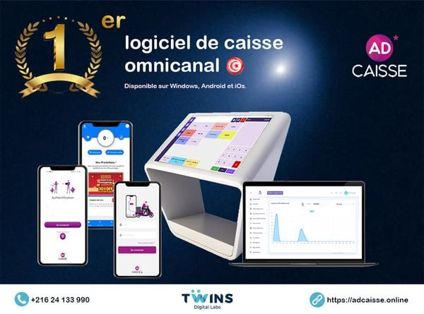
Adcaisse is a digital and connected touchscreen cash register, allowing all sales and operations to be carried out in all sectors.
What Adcaisse Platform is missing :
Dashboard for Partners Invoices
01
Notes:
This application can be installed on android, IOS and windows for all the different types of customers, this application has a backoffice that manages all of these applications , which is why it is important to create an administrative Dashboard for monitoring, managing Invoices, statistics and notifications (email, sms, etc.)

Slide 7
08
07
01
06
02
05
03
3- Study of the existing solutions
04
01

Slide 8
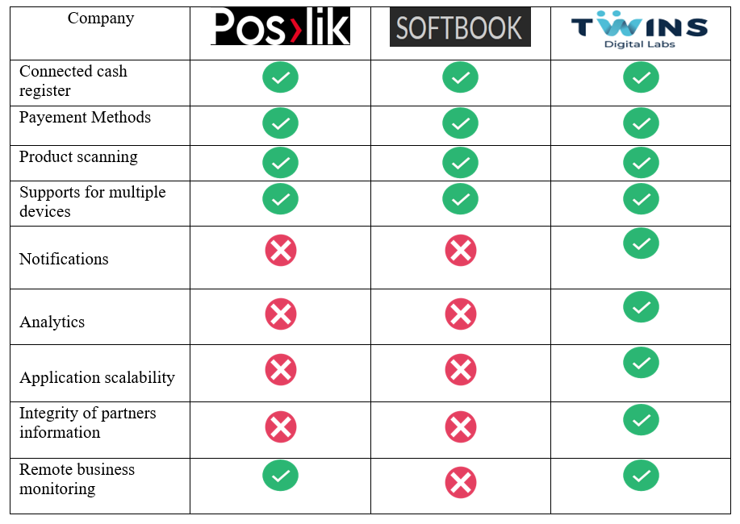
Benchmark of similar connected cash register applications :
01

Slide 9
What our dashboard add to the table :
The integrity of Customer Information.
Payments and Invoices management is easier to monitor.
portability: possibility of working with a simple PC or tablet
One single API for the hole Dashboard
Central dashboard that provides monitoring and analysis of all Adcaisse applications
01
Notes:
ADCAISSE est la premiere logiciel de caisse omnicanal en tunisie

Slide 10
08
07
01
06
02
05
03
04
4- Functional and non functional requirements
01

Slide 11


Functional requirements
Analytics
(charts)
Products
Management
Notifications
Management
Invoices
Management
Manage invoices for partners
01
Notes:
Taille 54

Slide 12
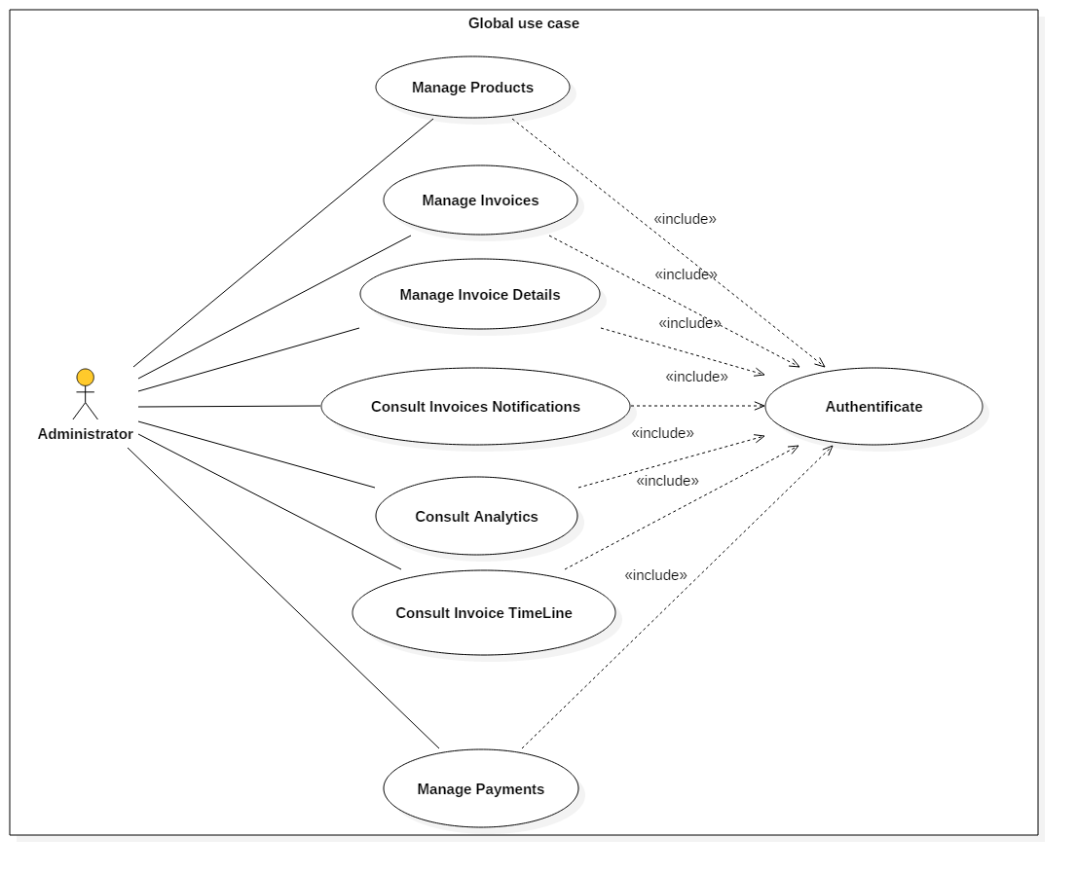
Global Case Diagram :
01

Slide 13
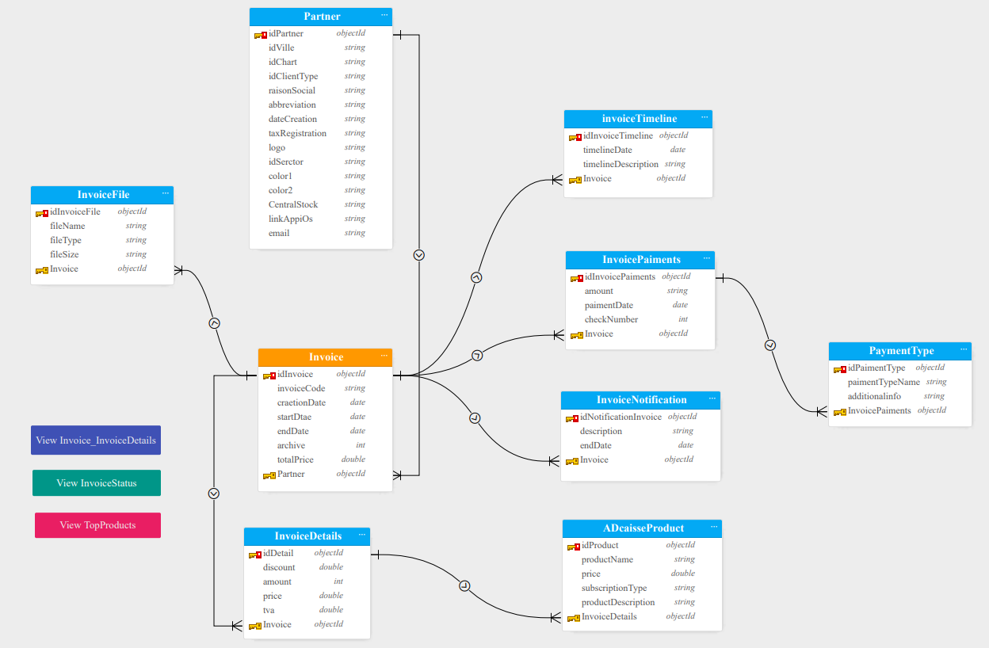
ER Diagram mongoDB:
01

Slide 14
Non functional requirements
-1-
Performance
-2-
Scalability
-3-
Reliability
-4-
Scalability
01

Slide 15
08
07
01
06
02
05
03
5- Technologies and architecture
04
01

Slide 16

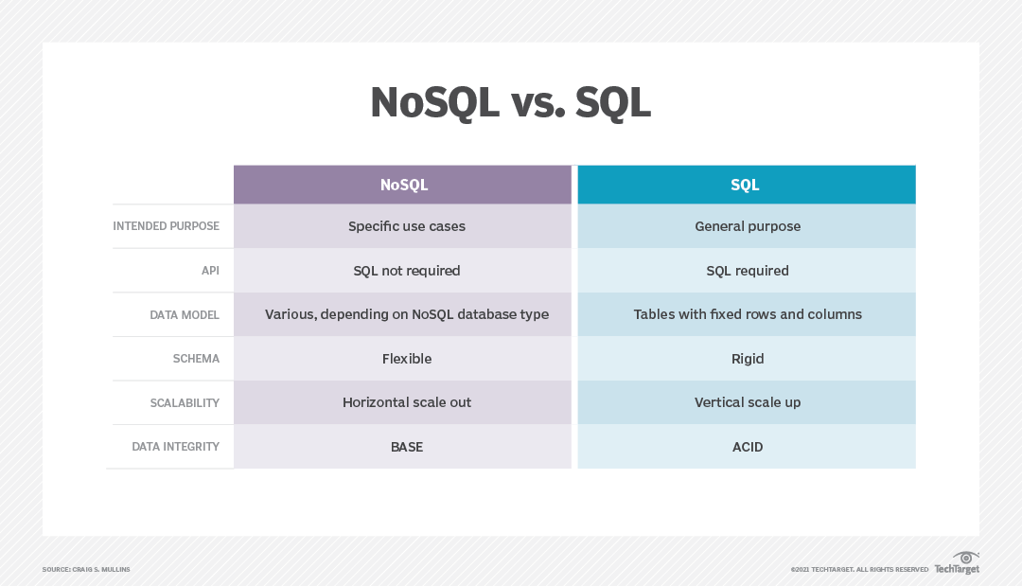
1-Data base
Mongodb :
Document oriented
NoSQL
Bson data base
01
Notes:
Les données sont stockées sous forme de collections et de documents
Avantage : Une orientation documentsD’excellentes performancesSimple à répliquerUne très bonne scalabilité,
des données en arbre

Slide 17

2-Backend :
SpringBoot
Spring boot is an open source, microservice-based java web framework
the server now has 11 APIs (Backoffice) + Persistence (has all the entities) which manages all the functionalities of the Adcaisse application.
Node js | Spring Boot
Highly scalable | Ease of modularity
Faster in performance | Robust Security
Ideal for i/o focused apps | Ideal for CPU intensive apps
01

Slide 18



3-Frontend :
Angular 11
Node 16
for performance it is mandatory to use the architecture of NGX admin and the primeng library for angular
01

Slide 19
Angular vs React :
Parameters of comparaison | Angular | React
Framework or Library | It is a front-end framework | It is a library.
Performance | It uses regular dom | It uses virtual dom
Scalability | It has a modular architecture | It has a component-based architecture
Learning curve | It has a steep learning curve | It has a simple learning curve
01

Slide 20

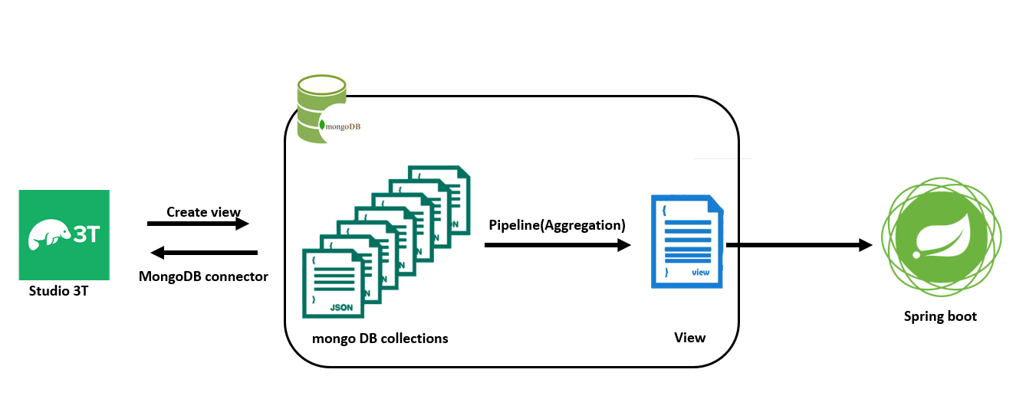
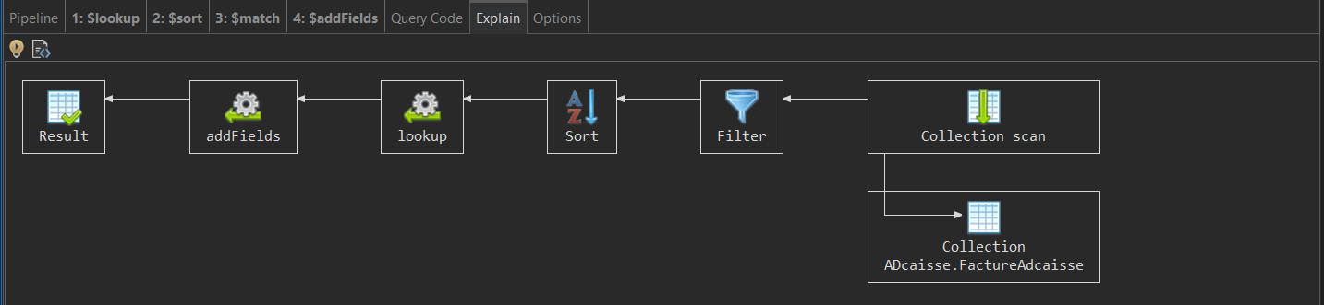
4-Analytics :
Charts visualization is a key in a dashboard(Studio 3T) :
01

Slide 21


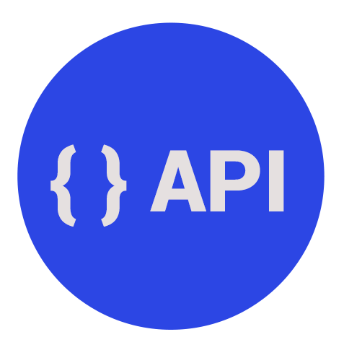

D3.js
Chart.js
01

Slide 22
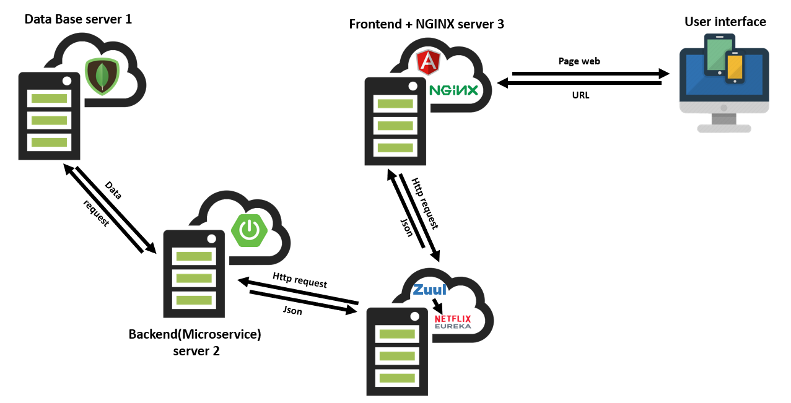
Physical architecture :

Slide 23







Physical Architecture :
Logical architecture :
Persistence : model +Repository
Model
Invoice management
Service
Lazy Module
Bp- api -otp
URL
Http / Json
API
GETAWAY
Components
Web page
bp- api -admin
Zull Server
User Dashboard Auth
01
Notes:
Change the architecture micro service
Zulll : load balancing
To google :
-centry

Slide 24






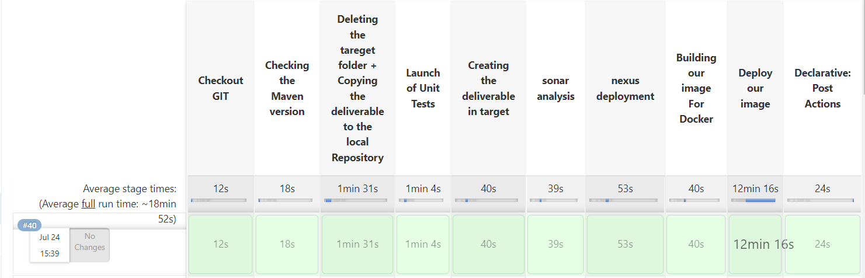
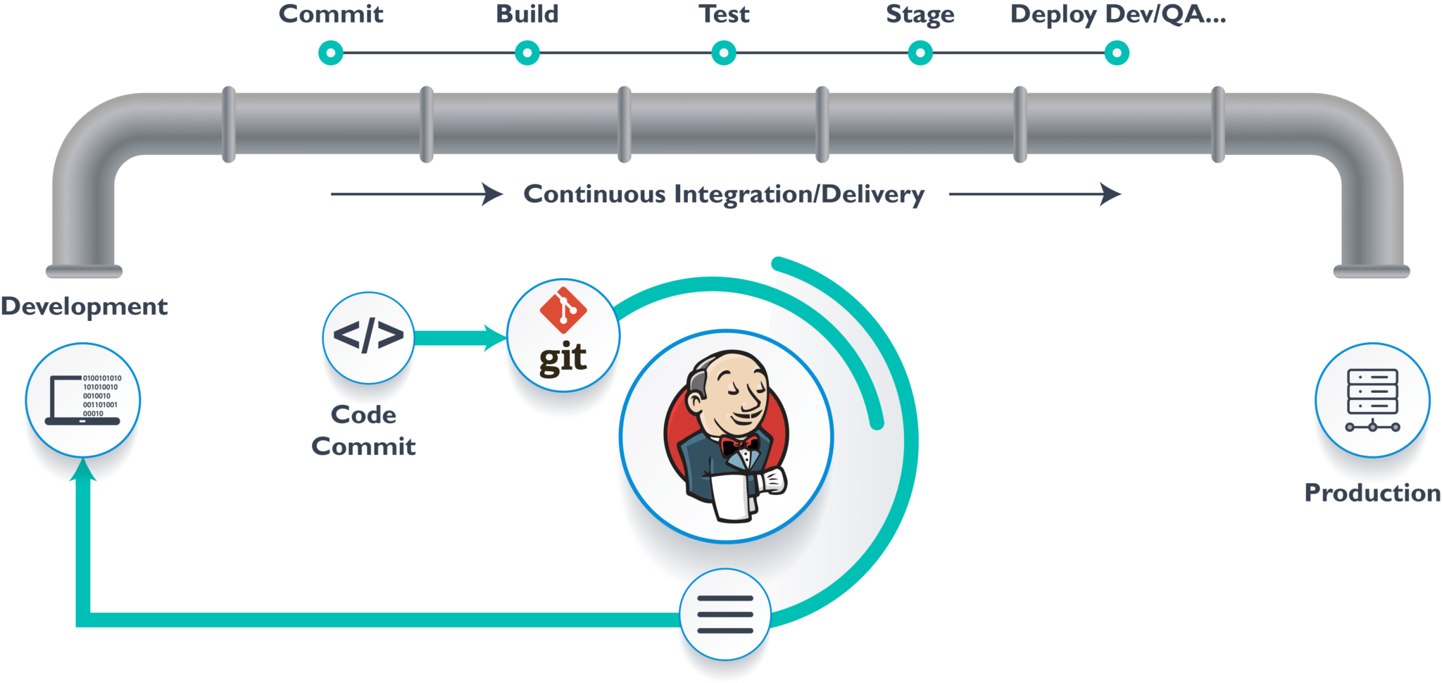

CI/CD pipeline (Devops) :

Slide 25
08
07
01
6- Sprints
06
02
05
03
04
01

Slide 26
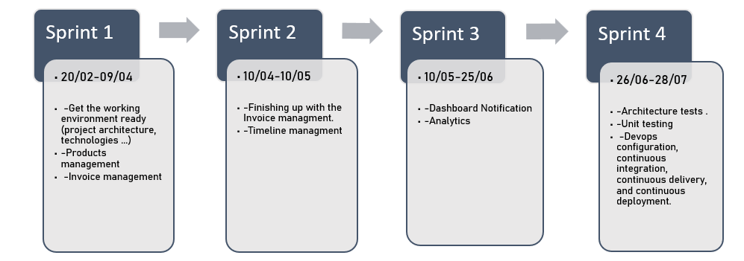
Sprint plan for this project :
01

Slide 27
08
7- Demonstration
07
01
06
02
05
03
04
01

Slide 29
6- Conclusion
08
07
01
06
02
05
03
04
01

Slide 30
thank you for your attention

